Slide 1
e-Yantra : Hola Bot
HB#2998

Slide 2
Team Members

Slide 3
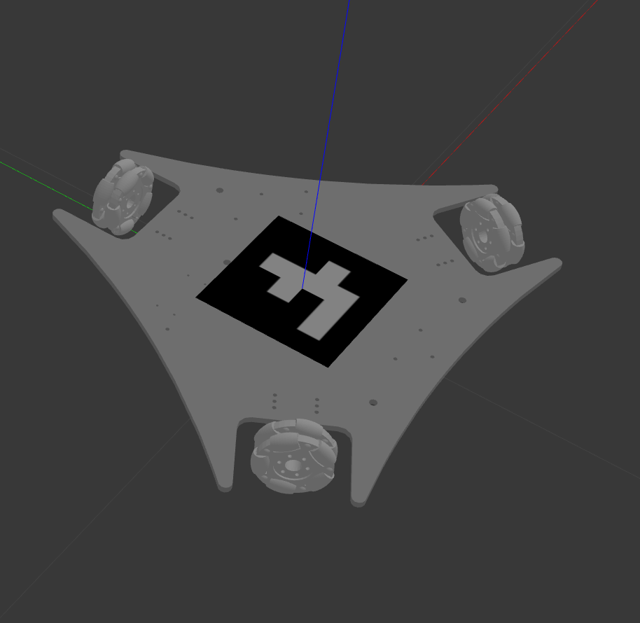

Progress so Far
Implementation of controller with simple /cmd_vel topic
Some Assumptions!
Implementation of controller using three different topic of forces on each wheel

Slide 4
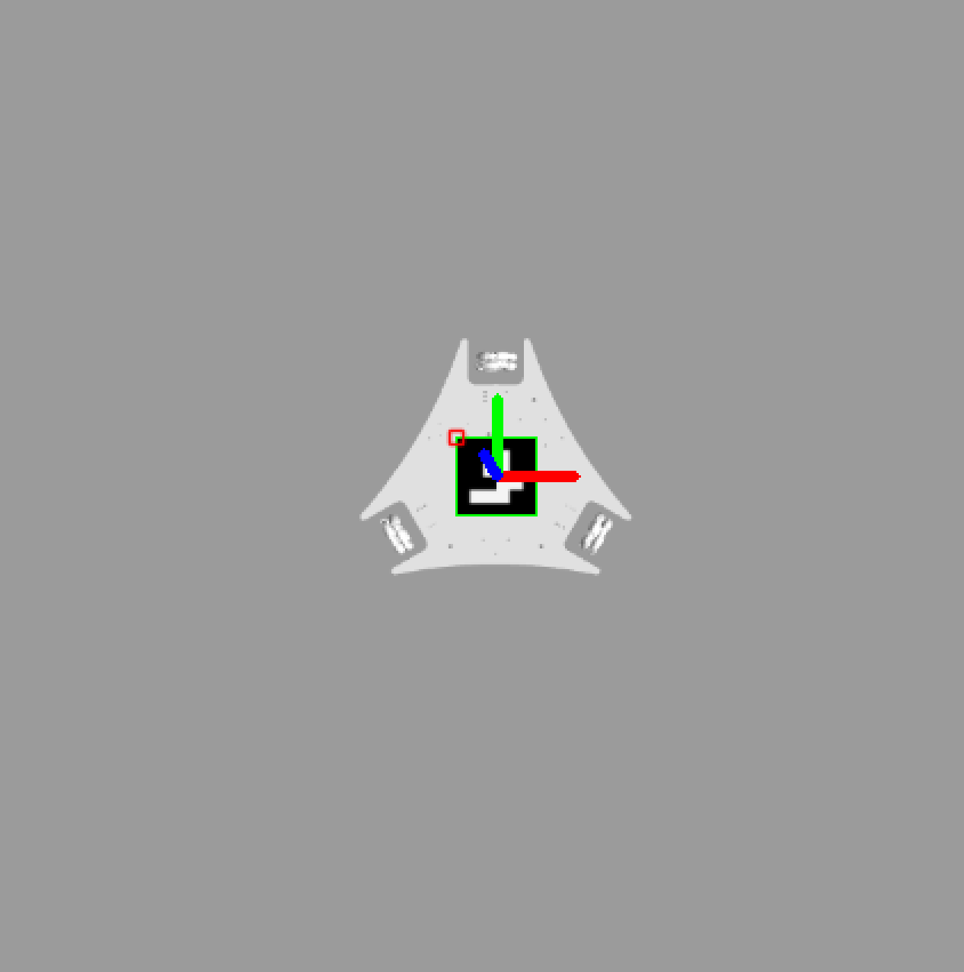

What are specs of our model?
What are the variables in our bot ?
What are the rostopics that we used ?
What are the physical equations?(kinematics)
How do we control the bot?
Role of ARUCO MARKERS
Making a pencil mount with chassis

Slide 5
Kinematic Equations

Slide 6

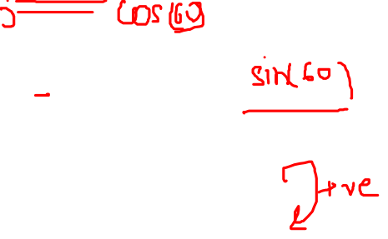
Condition of Equilibrium for a body
Fx = F1 - F2cos(60) – F3cos(60)
Fy = -F2sin(60) - F3sin(60)
Mz = F1 + F2 + F3

Slide 7
Rotation matrix for the three-wheeled omni-bot

Slide 8
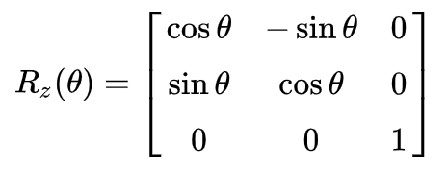

Rotation Matrix

Slide 9
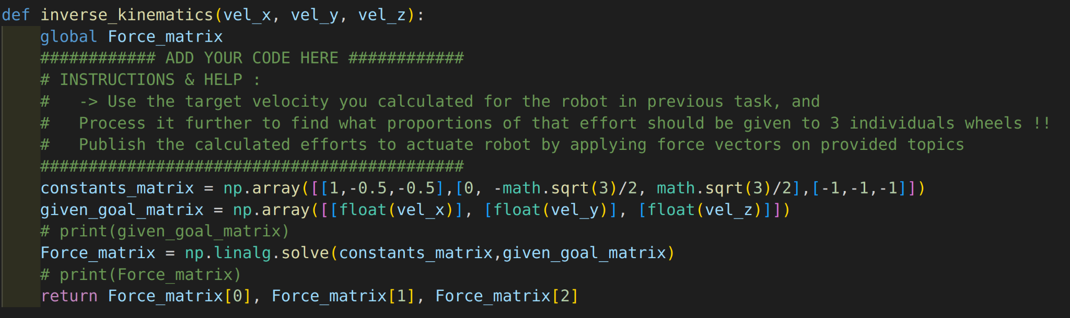

Inverse Kinematics

Slide 10
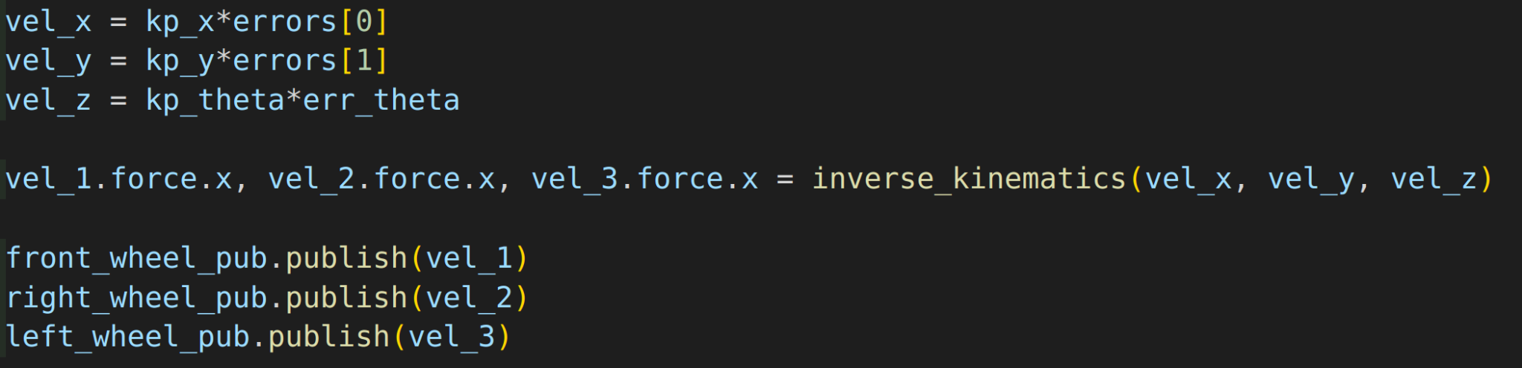

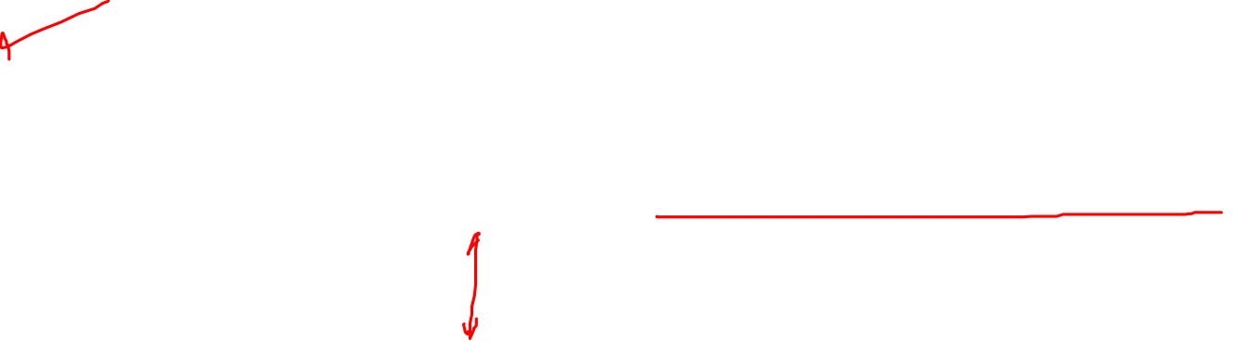
P-Controller

